Slide 1
Orientation New Volunteers
VITA / TCE Programs
2011
10/10/2011
NJ Integrated Training - 2007 Tax Season
1
Notes:
Hello! This presentation is for all new volunteers who are interested in participating in the VITA / TCE free tax preparation programs.
Notes/Handouts
10/10/2011
NJ Training TY 2008
1

Slide 2
Purpose Of This Module
Understand the IRS sponsored VITA/TCE programs
Understand what is expected of volunteers
Understand the tax return preparation process
Understand the available training
Notes:
01CourseIntro 2008x
2
This presentation covers four areas that are relevant to all new volunteers. The four areas which you will learn about are:
The two IRS sponsored programs – VITA and TCE;
What is expected of you, the volunteer;
The tax preparation process; and
The available training
This presentation is a general orientation – your organization may have additional information which you should receive directly from them. This may include additional program details such as location and hours of operation for their sites, additional programs which you can participate in such as Financial Education and Asset Building, Benefits Screening, as well as extra training.

Slide 3
VITA / TCE Programs
The following three slides contain content copied directly from the IRS website (http://www.irs.gov)
This specific page is at: http://www.irs.gov/individuals/article/0,,id=107626,00.html
Note: The content may be updated at any time.
Notes:
The VITA and TCE programs are described on the IRS website. You can go to the IRS website for more information. The following slides contain information that was current as of the date of the presentation.

Slide 4
VITA and TCE Programs
The IRS Volunteer Income Tax Assistance Program (VITA) and the Tax Counseling for the Elderly (TCE) Programs offer free tax help for taxpayers who qualify. Trained community volunteers may help with special credits, such as Earned Income Tax Credit, Child Tax Credit, and Credit for the Elderly or the Disabled. In addition to free tax return preparation assistance, most sites also offer free electronic filing (e-filing). Individuals taking advantage of the e-file program will receive their refunds in half the time compared to returns filed on paper – even faster when tax refunds are deposited directly into one's bank account.
Source: www.irs.gov (Free Tax Return Preparation for You by Volunteers)
Notes:
There are two free tax preparation programs supported by the IRS: VITA which stands for Volunteer Income Tax Assistance and TCE which stands for Tax Counseling for the Elderly – we’ll talk more about each program in the next few slides.
To start, take a moment to read this introduction from the IRS website…
There are some important messages here:
The programs are community based and staffed by volunteers
The programs are free to the taxpayer
The volunteers are trained to be able to help with tax issues which benefit those who need it most especially with obtaining credits which they may be entitled to, but which difficult to understand or involve special requirements or paperwork
Free electronic filing and direct deposit of refunds are also available and can help get your refund faster than you might think

Slide 5
VITA
The VITA Program offers free tax help to low- to moderate-income (generally, $49,000 and below) people who cannot prepare their own tax returns. Certified volunteers sponsored by various organizations receive training to help prepare basic tax returns in communities across the country. VITA sites are generally located at community and neighborhood centers, libraries, schools, shopping malls, and other convenient locations. Most locations also offer free electronic filing.
Source: www.irs.gov (Free Tax Return Preparation for You by Volunteers)
Notes:
This is the description of the VITA program from the IRS website. Please take a moment to read it.

Slide 6
TCE (and AARP Tax-Aide)
….As part of the IRS-sponsored TCE Program, AARP offers the Tax-Aide counseling program at more than 7,000 sites nationwide during the filing season. Trained and certified AARP Tax-Aide volunteer counselors help people of low-to-middle income with special attention to those age 60 and older.
Source: www.irs.gov (Free Tax Return Preparation for You by Volunteers)
[Note: AARP Tax-Aide is the only TCE program in NJ]
Notes:
And this is the description of the TCE / AARP Tax-Aide program from the IRS website. Please take a moment to read it.

Slide 7
VITA / TCE Notes
VITA
There are many independent organizations in New Jersey offering free tax preparation under the VITA program.
These include United Ways, local non-profits, churches, and other groups.
TCE (and AARP Tax-Aide)
AARP Tax-Aide is the only organization in New Jersey offering free tax preparation under the TCE program.
THE AARP Tax-Aide program is administered by the AARP Foundation which is separate from the rest of AARP.
There is NO AARP membership requirement to be a volunteer in the Tax-Aide program or to have your tax return prepared at a Tax-Aide site.
Notes:
How do these two programs compare in New Jersey?
First the differences:
There are over 100 independent local VITA organizations in New Jersey, but only one AARP Tax-Aide organization
The New Jersey VITA organizations are a diverse group – United Ways, local non-profit organizations, churches, and many others.
Although there is growing cooperation, each VITA organization in New Jersey historically has managed their own volunteers, provided their own training, and managed their own sites.
The New Jersey AARP Tax-Aide program is one state-wide organization, but is divided into county-based districts each of which handle local volunteers, training, and sites.
The New Jersey Tax-Aide program is part of a national program administered by the AARP Foundation.
The AARP Foundation is separate from the various other AARP activities.
Because AARP is part of the name, people sometimes assume that there is an AARP membership requirement to either participate as a volunteer in the Tax-Aide program or to have your return prepared at a Tax-Aide site – This is absolutely not the case.

Slide 8
VITA / TCE Notes
There are NO age restrictions for either program.
The last year we counted, the youngest taxpayer was 9 years old and the oldest was 102 years old.
The IRS provides some funding to support these programs, but the primary source of funding comes from the partner organizations.
The IRS SPEC (Stakeholder, Partnerships, Education and Communication) organization is dedicated to helping the VITA and TCE partners and volunteers.
Special training materials and publications
Local full-time staff
All volunteers must sign the Volunteer Agreement / Standards of Conduct (discussed later)
All volunteers involved in tax return preparation must pass the IRS certification test.
Notes:
Now, what is common between the two programs in New Jersey:
Taxpayers of any age can get their return by either program
The IRS provides some funding, but this is usually a supplement to funding from the partner organization
Locally for the various VITA organizations, and
Via a national grant for the Tax-Aide program
There is a group within the IRS dedicated to supporting these programs with an office in Newark with several full time staff
All volunteers in both programs must sign the same Volunteer Agreement (more on this shortly)
Those volunteers who are directly involved with tax return preparation must pass an IRS certification test.
Those volunteers not directly involved with tax return preparation must sign the Volunteer Agreement, but do not need to pass the IRS certification test.

Slide 9
National VITA Statistics
Served over 3 million taxpayers
Helped clients claim $3.5 billion worth of federal tax refunds
Saved families an estimated $550 million in tax preparation costs
NCTC (National Community Tax Coalition) affiliated VITA programs had over 2,300 sites and over 21,000 volunteers
Notes:
Although you might not have heard of either of these IRS programs, they are both large and well established. The next two slides give you a few statistics.
For VITA:
Served over 3 million taxpayers last year
Helped clients claim 3.5 BILLION dollars in federal tax refunds (note this does not count additional state tax refunds)
Saved families an estimated 550 million dollars in tax preparation costs
Most VITA organizations are affiliated with the NCTC which reported that their members operated over 2,300 sites with over 21,000 volunteers

Slide 10
National AARP Tax-Aide Statistics
Beginning our 43rd year
Operates in all 50 states
Served over 2.5 million taxpayers at approximately 6,000 sites
36,000 volunteers, almost all tax counselors
Notes:
For AARP Tax-Aide:
Has been providing free tax preparation services for over 40 years
Operates in all 50 states
Served over 2.5 million taxpayers at approximately 6,000 sites
Includes 36,000 volunteers
Nationally, the VITA and AARP Tax-Aide programs are roughly about the same size in terms of number of volunteers, people served, and number of local sites. The same is true for New Jersey.

Slide 11
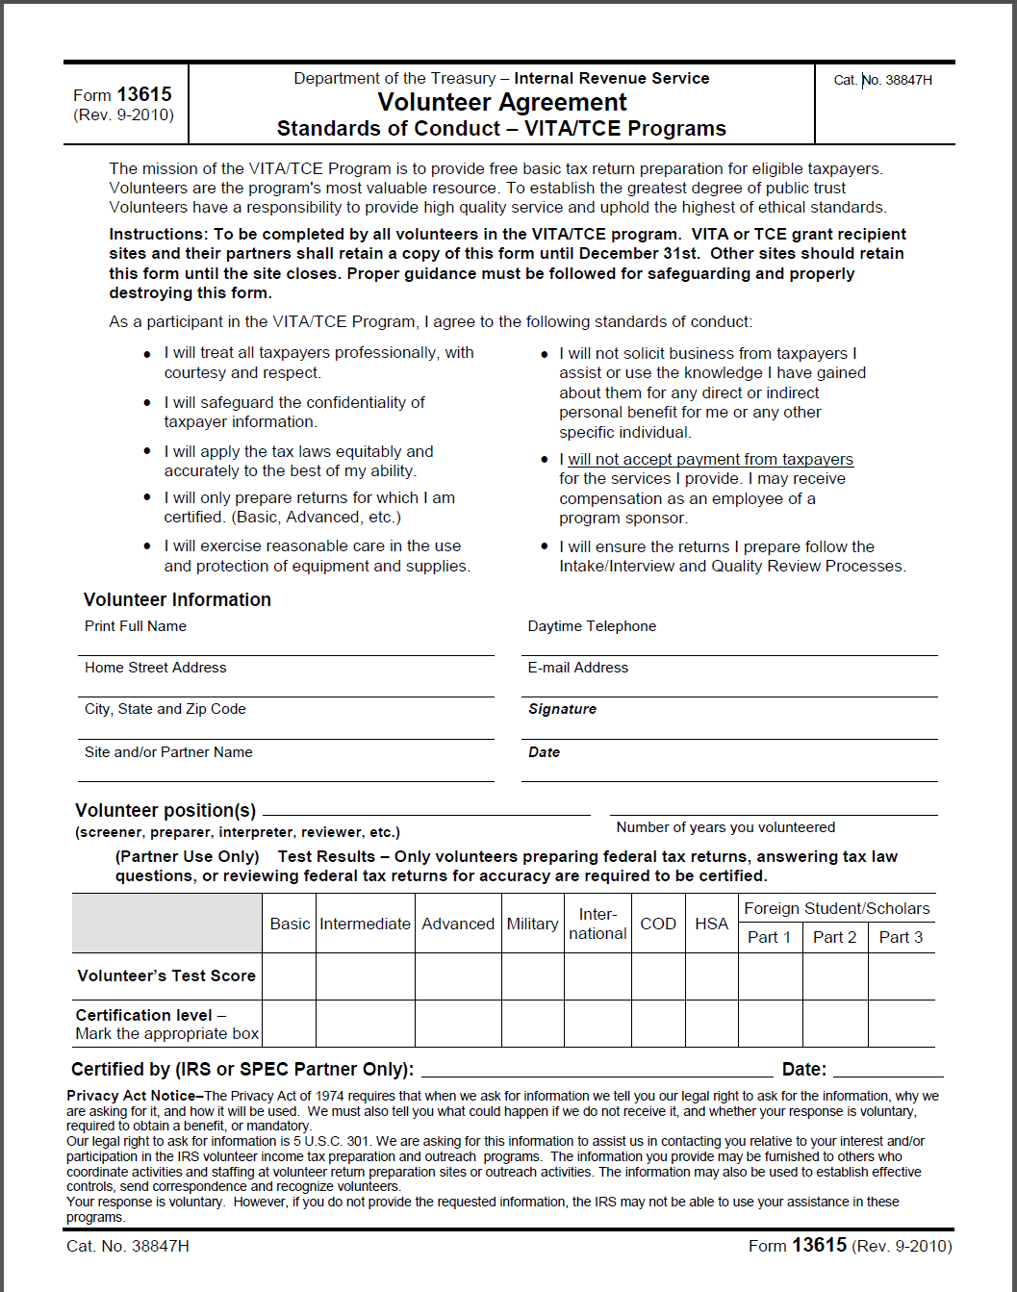
IRS Form 13615 (Volunteer Agreement / Standards of Conduct – VITA/TCE Programs)
Available online (http://www.irs.gov/pub/irs-pdf/f13615.pdf)
Standards of Conduct
Must be signed by all volunteers
Certification Test results
Only volunteers preparing federal tax returns, answering tax law questions, or reviewing federal tax returns for accuracy are required to be certified.
Notes:
We’re now going to talk about the IRS Volunteer Agreement / Standards of Conduct for the VITA/TCE programs.
We’ll be talking about the Tax Year 2010 version of this form. It may change for Tax Year 2011.
It is a simple one-page form with two main sections:
Standards of Conduct, and
Certification Test results
It is too small to read on this slide, but is available online from the IRS website.

Slide 12
Standards of Conduct
I will treat all taxpayers professionally, with courtesy and respect.
I will safeguard the confidentiality of taxpayer information.
I will apply the tax laws equitably and accurately to the best of my ability.
I will only prepare returns for which I am certified. (Basic, Advanced, etc.)
I will exercise reasonable care in the use and protection of equipment and supplies.
Notes:
To maintain the integrity of the free tax preparation programs and promote a high level of trust and confidence from taxpayers who use the program, there are a set of Standards of Conduct which, you, the volunteer must agree to adhere to. To work at a site, you must sign the Volunteer Agreement form. Your signature on the form indicates your agreement to live by these Standards of Conduct.
(read) Think about how you would want to be treated if you were on the other side of the table. People often come in feeling worried, resentful, uncertain, nervous or plain scared - Your demeanor and behavior will make a world of difference in your ability to put them at ease and establish effective communication.
(read) You will have access to a lots of sensitive information. Remember that conversations can be overheard, papers and computers can be lost or stolen, and so on. Again, think about how you would want your confidential information handled if you were on the other side of the table.
(read) Your feelings about the taxpayer or their situation should not affect the return. Do not bend the rules for anyone – even really friendly people with really sad stories. Within the bounds of the tax law, you can and should try to find the best result for the taxpayer, but you should never prepare a return which you are not comfortable will withstand scrutiny by the your Quality Reviewer, your Site Coordinator, or a strict IRS Auditor. If there is ever any question, you should always consult your reference materials and do not hesitate to ask for help.
(read) You are only allowed to prepare returns which include areas for which you have been trained and for which you have passed the relevant level of the IRS certification test. For example, if you haven’t passed the Advanced level on the IRS certification test, then you cannot prepare returns which involve topics which are only included in the advanced level, such as itemized deductions.
(read) Funding and availability of equipment is always limited. Not being wasteful or irresponsible will allow the program to serve more needy people.

Slide 13
Standards of Conduct (Con’t)
I will not solicit business from taxpayers I assist or use the knowledge I have gained about them for any direct or indirect personal benefit for me or any other specific individual.
I will not accept payment from taxpayers for the services I provide. I may receive compensation as an employee of a program sponsor.
I will ensure the returns I prepare follow the Intake/Interview and Quality Review Processes
Notes:
(read) Participation in the program with the intent of growing your real estate business or your husband’s house painting business is not allowed. Also, taxpayers will often ask for references to accountants or to other service providers – You must politely decline to provide such recommendations.
(read) Taxpayers often cannot believe that the service is free or they are so appreciative that they want to pay you something. You are absolutely not allowed to accept any form of compensation or payment from the taxpayer. They can make a cash donation to the site or they can put out a tray of cookies for everyone, but they cannot give anything to you individually.
(read) The IRS has established certain processes which much be followed. We will talk more about these in other presentations.

Slide 14
Liability and Insurance
By law, counselors are free from liability as long as they follow the volunteer agreement standards of conduct
Counselors are covered by different insurance depending on your affiliation
e.g. AARP insurance covers personal injury and death only (and after counselor’s personal insurance is used)
Notes:
A couple of other points:
What happens if the IRS requires extra payments from the taxpayer – are you liable as the return preparer? As long as you follow the standards of conduct in the Volunteers Agreements, the answer is no. The primary issues are that you not prepare returns for which you have not been trained and certified and that any errors not be the result of intentionally preparing an inaccurate return.
In addition to liability, there may be other kinds of insurance provided by your organization. Talk to your organization if you have particular concerns.

Slide 15
Tax Preparation Process
Tax returns are prepared at convenient local sites (e.g. libraries, churches, senior centers, etc.)
Start/End dates and hours of operation vary by site
Many sites require appointments; almost all sites accept walk-ins
Some organizations may offer special services for home-bound taxpayers
All tax returns are prepared in the presence of the taxpayer
New volunteers are assigned to work at one (or more) sites
Experienced volunteers at the site mentor the new volunteers to ease them into the process
All volunteers are expected to commit to a schedule of at least 4 hours per week during the tax season (vacations are allowed)
Tax returns are prepared on computers with TaxWise software
Many sites / organizations will supply computers for return preparation, but use of your personal laptop is encouraged
TaxWise (either the desktop version or online version) is the only software which may be used by the volunteer programs
Notes:
Now, lets talk a little about the tax preparation process.
If you are involved in preparing returns, you will work at one or more sites. There are hundreds of sites around New Jersey operating on different days of the week and different hours of the day or evening. You should work with your organization to figure out which sites are most convenient and best fit your schedule. Taxpayers bring their paperwork to the sites where you work with them directly to prepare their tax returns. Typically we are able to able to prepare their complete return in one visit.
Even if you complete all the training and pass all the tests, it good to know that there will be seasoned volunteers at your site to help you learn the ropes and to help you apply and build your skills. Like many things, it is good to be able to observe experienced preparers and to have coaches and mentors available as you begin to apply what you have leaned. Every site and organization is used to helping and encouraging new volunteers along every year. Because it is a big investment on your part and on the part of your organization to get you trained, there is an expectation that you will be able to commit to a minimum amount of time at sites preparing returns during the tax season (late Jan / early Feb to mid April)
A large part of your training will involve learning to use a professional tax preparation program called TaxWise which the IRS provides at no cost to the free tax preparation programs. There is no charge to you for using this software. The IRS and most organizations will even supply computers if you don’t have your own laptop to use. Even if you have experience with other tax preparation software (e.g. TurboTax for your personal return), you must, however, use TaxWise for all returns prepared under the auspices of the free tax preparation programs. You can also use the software to prepare and e-file your own return as long as you follow all the standard processes.

Slide 16
Tax Preparation Process (Con’t)
Preparers work with the taxpayer to obtain the necessary information to be entered into the TaxWise program
Using an interview process and associated Intake Sheet questionnaire
Preparers will be provided with and should use standard IRS and locally developed reference materials
When in doubt, look it up; If still not sure, ask for help from your Site Coordinator
If you are not trained and certified in any aspect of a tax return, then the taxpayer must be referred back to the site coordinator for re-assignment
If outside the scope of the program, then the taxpayer must seek help from a paid preparer
All tax returns must be reviewed by a second certified counselor for accuracy
Even the simplest tax returns prepared by the most expert preparers
Notes:
So how do things actually work at a site?
You work directly with the taxpayer to obtain the necessary information to complete the return. The IRS has developed forms, procedures, and interview techniques which provide structure and consistency for this process. These have been refined over many years and are covered in detail as part of your training. You are also provided with free copies of various paper and online reference materials which will help you to prepare an accurate return. Your training will also teach you how to use these materials and give you lots of opportunity to practice. Remember – The tax law and the TaxWise software are way too complicated for anyone to be able to remember everything – even the most experienced preparers will need to consult their materials on a regular basis. Especially when you’re new, but even after many years, there will still be things which you are not sure about – it is perfectly ok (and the taxpayer will appreciate it) if you use your reference materials to look up the answer. When all else fails, ask for help – someone at your site will either know the answer or know how to find it.
There are, however, limits on what you are required or are allowed to do. If you haven’t been trained and certified in an aspect of the taxpayer situation, you must refer them back to the site coordinator so they can either re-assign the return to a preparer who is trained and certified in that aspect of tax law. There are also topics which are outside the scope of the free volunteer programs entirely (such as rental income, returns for other states, complicated stock transactions, and so forth). Your site coordinator will refer these taxpayers to a regular paid tax preparer.
An important part of the process deserves special mention – All returns must be reviewed by a second certified preparer for accuracy. This is good for the taxpayer and good for you. Even with the best software it is possible to make simple data entry mistakes or miss checking a box which can have dramatic impact on the tax liability. Just like proof-reading a document you have written, a second set of eyes will often catch things that you would miss. The discussion you have with the reviewer is a great way for you to learn new aspects of the software, learn new ways to use your reference materials, or to refine and correct you understanding of tax law issues.

Slide 17
Tax Preparation Process (Con’t)
The tax return is explained to the taxpayer and a printed copy is provided for their records
Completed tax returns are submitted electronically (e-filed) by an ERO (Electronic Return Originator)
Tax returns are usually sent as a group after the site closes for the day
There are a few unusual situations in which the taxpayer will be required to submit their own tax return on paper
Payments and refunds are handled directly with the IRS or NJ Division of Taxation
Paper check (slower) or direct deposit (quicker)
Some sites / organizations offer additional services (Financial Education and Asset Building in IRS parlance)
Notes:
At the end of the day, the returns you prepare are the responsibility of the taxpayer - so explaining the return to them and providing a printed copy for their records is an important part of the process.
There is one (or more) individuals at each e-file site who is actually authorized by the IRS to submit e-file returns. This person is called the ERO (Electronic Return Originator). The returns you prepare are not actually seen by the IRS (and the state) until the ERO for your site sends the e-file version of the return to the IRS. This typically happens later in the day.
You are not involved in handling payments or refunds. You may prepare the voucher for mailing or the direct deposit forms, but the actual money flows directly to or from the taxpayer. Most of our taxpayers get refunds and getting these refunds quickly and without hidden fees is a great benefit to them. By offering free e-filing of returns, we get the return to the IRS in the fastest (and most accurate) way possible; and by encouraging direct deposit we get their refund to them in the fastest (and safest) way possible.
There are many other services from governmental or private agencies which depend on information from the tax return. The refund received from the IRS may also be the largest single payment of any kind the taxpayer receives during the year. As a result, many organizations who offer other kinds of financial education and assistance to the community will leverage their tax preparation service to provide valuable tie-ins to their other services.

Slide 18
New Volunteer Training
Training is free and all modules are available online
go to www.TaxPrep4Free.org and click on Training
All New Volunteers
Understand the mission of the programs, standards of conduct, and tax return preparation process (Orientation)
Note: there may be additional organization and/or site specific training required
New Preparers
Explained in following slides
Others Roles
Role specific training as appropriate (e.g. Site Coordinator, ERO)
Not discussed further as part of Orientation
Notes:
Let’s talk about training for new volunteers. First of all – All training is absolutely free!
The first training step for all new volunteers is to understand the mission, standards of conduct, and the return process for the free tax preparation programs – That’s what this presentation is all about. Your organization or the sites you work at may have additional training requirements, please check with them.
Most volunteers end up being preparers – we’ll talk more about training for preparers in a minute.
In addition to preparers, there are many other activities available to volunteers – greeters, technical support, communications, and marketing to name a few. Training for these roles will not be covered as part of this presentation – talk to your organization for details.
Even for preparers there are specialized roles such the ERO role we discussed earlier which also are beyond the scope of this presentation.

Slide 19
New Preparer Training
Build skills and knowledge so can join with returning preparers for current year (TY2011) training in December
Based on prior year (TY2010) to allow early start
Three steps:
Familiarization – Learn to use the software without worrying about tax law issues
Tax Law – Learn relevant tax law for returns we are allowed to prepare (federal and NJ)
Proficiency – Demonstrate the ability to apply tax law and software best practices to prepare high quality, accurate returns
IRS Certification levels – Basic, Intermediate, and Advanced
Other levels (Military, International) not supported by our training
Self-paced
Based on IRS standard materials plus locally developed webinars, screencasts, narrated presentations, guidelines, checklists, etc.
Emphasis on building necessary skills to prepare returns using supplied software
Will require at least 40 hours between now and December
Individually assigned coaches plus local in-person workshops for individualized assistance
Regular classroom training may also be available
Notes:
You first year as a volunteer preparer is a special challenge. You will need to learn all the ins and outs of federal and state tax law and build a level of comfort with the tax preparation software we use that allows you to pass the same certification test that returning volunteers must pass each year. This is a big hill to climb, but training for new volunteers is comprehensive and has been refined and improved over many years. Every year there are thousands of people just like you who go through the process successfully.
One way to think about your training as a NEW preparer is that you want to get caught up with all the tax law and software knowledge and skills of the returning preparers by sometime in December so that you and they can both focus on just What’s New in January before the tax season begins in earnest. To facilitate this and to allow new preparers to start early our new volunteer training is based on prior year (Tax Year 2010) tax law and software. This has the added benefit of allowing new preparers to work with existing publications and stable, complete software including not just federal, but New Jersey modules.
There are three major steps in new preparer training:
Familiarization – Getting comfortable with the software without having to deal with messy tax law issues
Tax Law – Learning the relevant federal and state tax law
Proficiency – Combining knowledge of tax law and software skills to prepare accurate returns
The IRS recognizes several levels of certification: Basic, Intermediate, and Advanced. There are other specialized levels such as Military or International which are recognized by the IRS, but which are not part of our new preparer training. Depending on your organization or site, you may be required to achieve a minimum level of certification.
The materials on this site are intended to supplement the standard IRS training materials with narrated presentations (such as this one), activity checklists, reference guides, screencasts showing actual TaxWise preparation activities, and live webinars. The intent is that you can learn the tax law and TaxWise skills necessary to confidently prepare the kinds of returns you will see at the free tax preparation sites. This is a non-trivial amount of work – you should expect to spend at least 40 hours between now and December.
Many organizations have a program where new preparers are assigned experienced preparers as coaches to provide personalized assistance for new preparers. Your organization may also offer instructor led classes, workshops, and review sessions based on the above.

Slide 20
Final Thoughts
It takes a lot of work to get through all the preparer training and pass the IRS certification and the proficiency requirements during your first year, but…
There are many ways to contribute without being a certified preparer
There are thousands of others just like you who have already done it
The knowledge and practical skills you build will be useful in allowing you to make better financial decisions in your own personal life and could possibly open up new long-term career opportunities
You will be joining a group of dedicated volunteers who find it worthwhile to come back year after year
Although the first year training can be a lot of work, the following years are much easier
On the other hand, those who have been part of the program for 20+ years say they still learn something new every season
There are few other volunteer activities that allow you to have such a significant positive impact on needy individuals in your local community
Notes:
Some final thoughts…
Just read it (with feeling)

Slide 21
Next Steps
All Volunteers:
Take the Orientation Quiz, then…
For Preparers:
Familiarization
Work with your Training Coordinator to get TaxWise Online User training account setup
Follow steps in Familiarization checklist
For Non-Preparers:
Depends on organization and role…
Notes:
Next Steps
To complete the Orientation step, you need to take the quiz – it is a separate presentation.
If you want to be a preparer, then talk to your Training Coordinator about getting access to the software and go print out a copy of the Familiarization Checklist. Follow the Familiarization Checklist steps in order.
For non-preparers or preparers who wish to take on additional responsibilities, you should follow up with your organization.
Thank you for volunteering and good luck with your training. Those whom you help appreciate all your efforts…

